Slide 1


Top Performing Category Types

Slide 2


Today's agenda
Project recap
Problem
The Analytics team
Process
Insights
Summary

Slide 3

Social Buzz, a rapidly growing platform with 500 million monthly users, seeks external expertise for a 3-month project. The focus includes an audit of big data practices, recommendations for a successful IPO, and analysis of top 5 content categories. With limited resources and a commitment to user anonymity, Social Buzz looks to leverage the advisory firm's experience in handling massive data and scaling challenges for optimal growth and strategic guidance.
Project Recap

Slide 4


Problem
Social Buzz faces three main challenges necessitating external expertise:
Unprecedented Scale: Rapid growth has resulted in the creation of massive unstructured data (100,000+ daily posts), requiring sophisticated technology.
Resource Limitations: With 250 employees, including 200 technical staff, Social Buzz seeks external support due to resource constraints in managing their current scale.
IPO Preparation: Anticipating an IPO by next year, Social Buzz requires guidance and best practices to ensure a smooth and successful public offering.

Slide 5



ANDREW FLEMING
Chief Technology Architect
The Analytics team
MARCUS ROMPTON
Senior Principal
NARMADHA R
Data Analyst

Slide 6
Process
1
Data Understanding
2
Data Cleaning
3
Data Modelling
4
Data Analysis
5
Uncover Insights

Slide 7
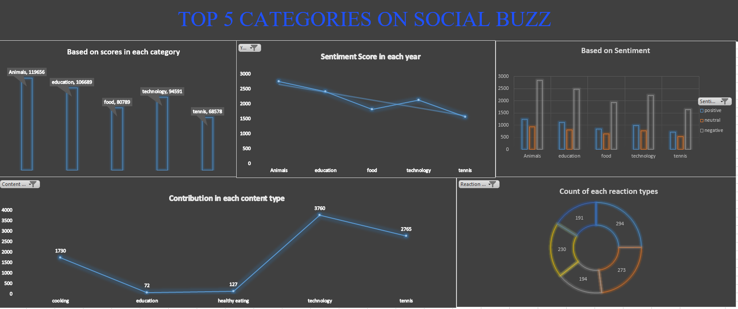

Slide 8

Insights
Animal is the top category
Negative sentiment is high in all categories
Adore is the most used reaction

Slide 9

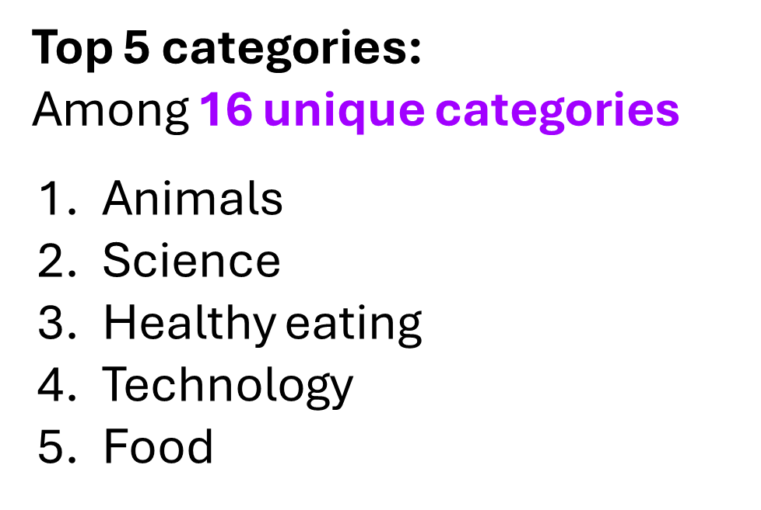
Summary

Slide 10

Thank you!
ANY QUESTIONS?

